Slide 1
E6321 – Adv. Digital Electronics Midterm Project Review
32-bit RISC microprocessor with SIMD extensions design
Team: PlusOneSecond

Slide 2
Outline
Background
Project Goal
SIMD implementation of Matrix Computations
Block Diagram
Behavioral Description & Verification
Timeline
Reference
Q & A

Slide 3
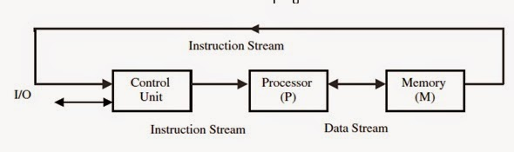
Background
Original RISC (SISD):
Based on loops.
Fetching of array elements from memory based on individual loads and stores.
Single Instruction operates on single data (e.g., a scalar).
Instruction dependences must be identified for each instruction.

Slide 4
Background
SIMD Architecture:
SIMD architectures can exploit significant data-level parallelism for:
Matrix-oriented scientific computing
Media-oriented image and sound processors
SIMD is more energy efficient than MIMD
Only needs to fetch one instruction per data operation
Makes SIMD attractive for personal mobile devices
SIMD allows programmer to continue to think sequentially (compared to MIMD) and achieve parallel speedups

Slide 5
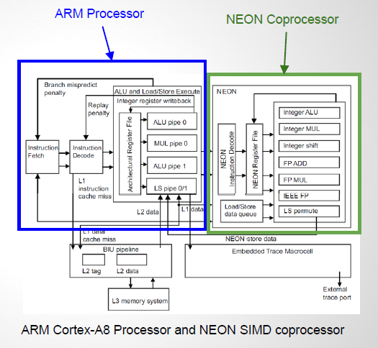
Background
ARM Neon
Separate sequential and SIMD processors
Instructions fetched in ARM processor and sent to NEON coprocessor
Specialized Instructions: VZIP, VMLA, VRSQRTE……
Intel SSE
SIMD instructions executed along with sequential instructions
Specialized Instructions: PAVG, DPPS…….

Slide 6
Project Goal
Execute a full VLSI design flow from RTL design to Place and Route with custom standard cell.
Customize a 32-bit RISC embedded microprocessor with SIMD instruction extensions.
Implement efficient SIMD executions of matrix multiplication, matrix transposition and other computations (e.g. FIR filter).

Slide 7
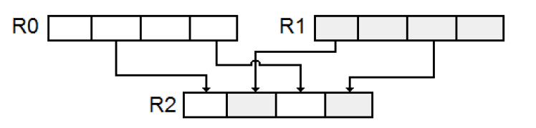
SIMD implementation of Matrix Computations
Instruction Set (32-bit instruction word)
ALU Commands: ADD, SUB, INC…
Load/store Commands: LD, ST…
Jump Commands: JMP, JAL, JNC, JC…
VALU Commands: VADD, VSUB, VAND…
Transfer Commands: VLD, VST, MOV…
Shuffle Commands: VSHUF…
Other: VNOP, VMOL, VMOR…
Shuffle:

Slide 8
SIMD implementation of Matrix Computations
Matrix Transpose
Assuming 4*4 matrix:
Non-SIMD Implementation:
16 Loads (LD)
16 Stores (ST)
Total 32 Instructions
SIMD Implementation:
4 Loads (VLD)
8 Shuffles (VSHUF)
4 Stores (VST)
Total 16 Instructions

Slide 9
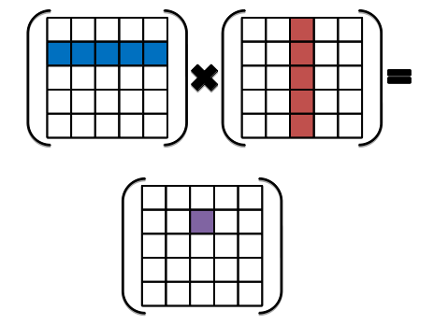
SIMD implementation of Matrix Computations
Matrix Multiplication
Assuming 4*4 matrix:
Non-SIMD Implementation:
32 Loads
For one element:
4 Multiplications
3 Adds
16 Stores
Total 160 Instructions
SIMD Implementation:
8 Loads
For one row vector:
4 Multiplications
8 Shuffles
3 Adds
4 Stores
Total 72 Instructions

Slide 10
Block Diagram
System
Memory Interface: control vectorization
Memory: instructions & Data

Slide 11
Block Diagram
CPU
Accumulator-architecture
Separate Vector Unit

Slide 12
Block Diagram
Vector Execution Unit
k * Vector Slice
Shuffle Unit

Slide 13
Behavioral Description & Verification
Verified Modules:

Slide 14
Behavioral Description & Verification

Slide 15
Timeline
Week 11-12: Behavioral Model, Module Synthesis, Verification
Week 13-14: Overall Synthesis, P&R, Annotation
Week 15-16: Global Design, Timing Closure, Layout

Slide 16
Reference
Lecture Slides of E6322
Development of a configurable Vector processor, Harald Manske, Fachhochschule Augsbur
OpenCore

Slide 17
Q & A

